Slide 1
Cubs Quiz
https://www.facebook.com/groups/50thCambridgeCubs
http://www.50thcambridgescouts.org/cubs

Slide 2
Round 1
Robots

Slide 3
Who is the first hero robot we meet in the Star Wars saga (Episodes 1-9)?
A
A
B
R2-D2
BB-8
C-3PO
K-2SO
B
C
D
D
C

Slide 4
Who is the first hero robot we meet in the Star Wars saga (Episodes 1-9)?
A
A
B
R2-D2
BB-8
C-3PO
K-2SO
B
C
D
D
C

Slide 5
Which robot was the hero in Disney’s Wall-E?
A
B
C
D

Slide 6
Which robot was the hero in Disney’s Wall-E?
A
B
C
D

Slide 7
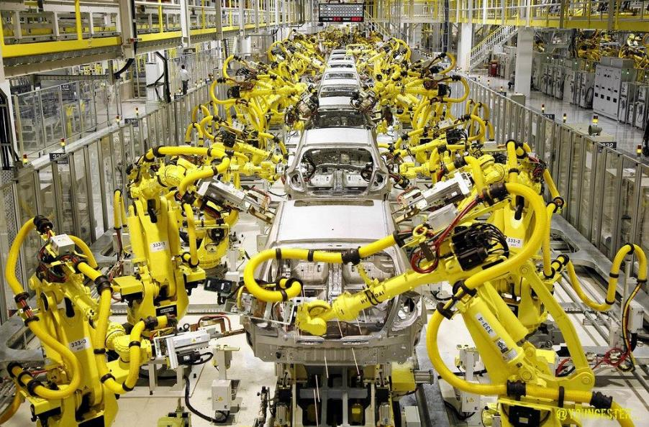
How many robots are in this picture?
A
12
34
86
None
B
C
D

Slide 8
How many robots are in this picture?
A
12
34
86
None
B
C
D

Slide 9
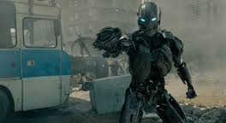
Which Marvel Movie features an army of evil robots?
A
Avengers Assemble
Iron Man
Age of Ultron
End Game
B
C
D

Slide 10
Which Marvel Movie features an army of evil robots?
A
Avengers Assemble
Iron Man
Age of Ultron
End Game
B
C
D

Slide 11
Which one of these is Vector (the robot toy)?
A
B
D
C

Slide 12
Which one of these is Vector (the robot toy)?
A
B
D
C

Slide 13
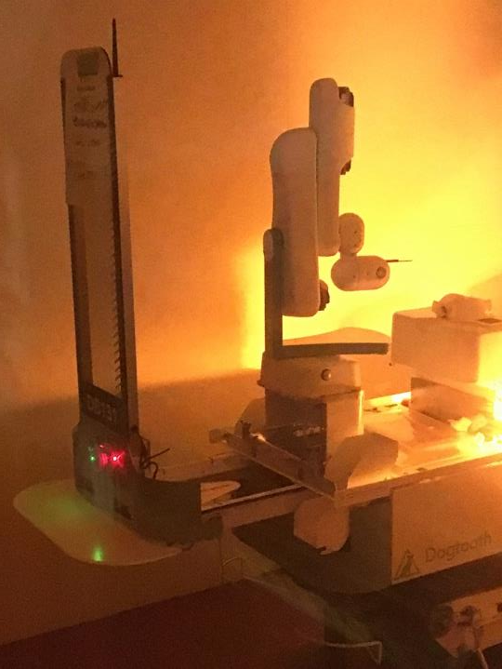
What does this robot do?
A
Picks Up Litter
Makes Pizzas
Fights Forest Fires
Picks Strawberries
B
C
D

Slide 14
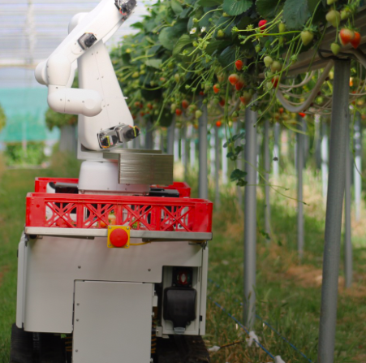
What does this robot do?
A
Picks Up Litter
Makes Pizzas
Fights Forest Fires
Picks Strawberries
B
C
D

Slide 15
Round 2
Animals

Slide 16
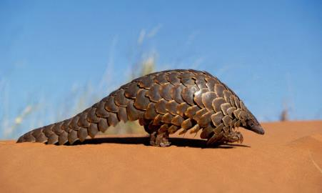
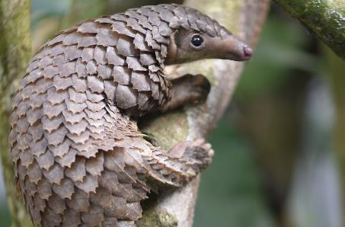
What is this animal?
A) Anteater
B) Armadillo
C) Pangolin
D) Aardvark

Slide 17
What is this animal?
A) Anteater
B) Armadillo
C) Pangolin
D) Aardvark

Slide 18
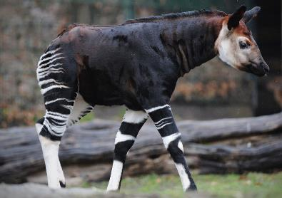
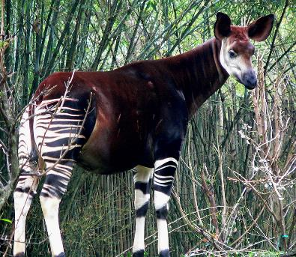
What is this animal?
Okapi
B) Donkey
C) Zebra
D) Zonkey

Slide 19
What is this animal?
Okapi
B) Donkey
C) Zebra
D) Zonkey

Slide 20
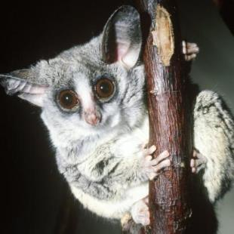
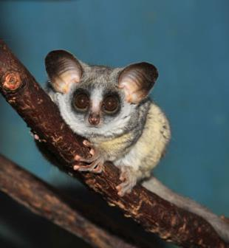
What is this animal?
Chinchilla
Bush Baby
Squirrel
Monkey

Slide 21
What is this animal?
Chinchilla
Bush Baby
Squirrel
Monkey

Slide 22
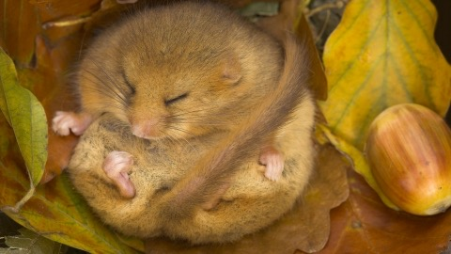
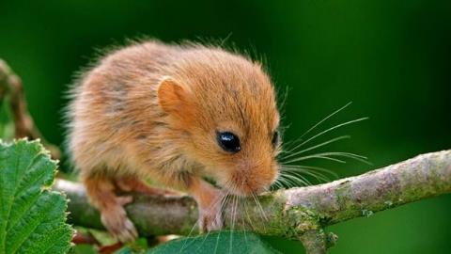
What is this animal?
Hamster
Gerbil
Harvest Dormouse
Rat

Slide 23
What is this animal?
Hamster
Gerbil
Harvest Dormouse
Rat

Slide 24
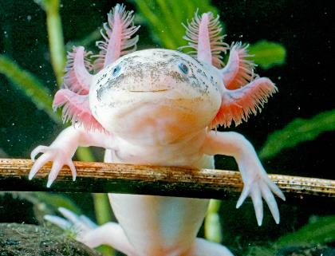
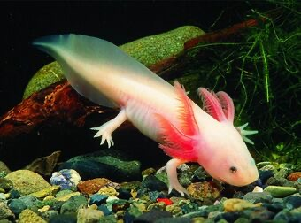
What is this animal?
A) Eel
B) Frog
C) Squid
D) Axolotl

Slide 25
What is this animal?
A) Eel
B) Frog
C) Squid
D) Axolotl

Slide 26
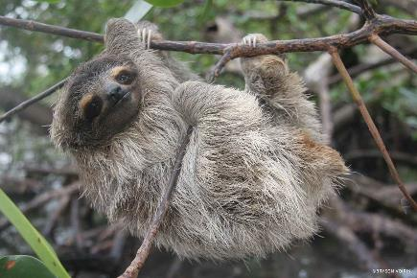
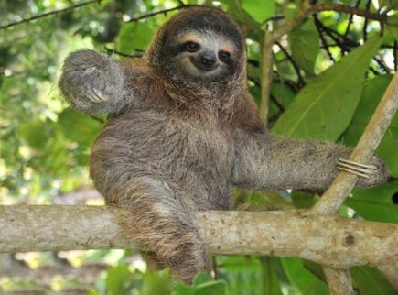
What is this animal?
Pygmy 3 toed sloth
Gorilla
Tree Bear
Orangutan

Slide 27
What is this animal?
Pygmy 3 toed sloth
Gorilla
Tree Bear
Orangutan

Slide 28
Round 3
Badges

Slide 29
What badge is this?
Hobbies
Horse Riding
Toy making
Knight Training

Slide 30
What badge is this?
Hobbies
Horse Riding
Toy making
Knight Training

Slide 31
What badge is this?
Food and Drink
Baking
Gardening
Farming

Slide 32
What badge is this?
Food and Drink
Baking
Gardening
Farming

Slide 33
What badge is this?
Holiday
Air Activities
Pilot
Royal Air Force

Slide 34
What badge is this?
Holiday
Air Activities
Pilot
Royal Air Force

Slide 35
What badge is this?
Electrician
Nights Away
Outdoor Activities
Night Hike

Slide 36
What badge is this?
Electrician
Nights Away
Outdoor Activities
Night Hike

Slide 37
What badge is this?
Gardening
Baking
Artist
Chef

Slide 38
What badge is this?
Gardening
Baking
Artist
Chef

Slide 39
What badge is this?
Face Painting
Artist
Entertainer
Mask Making

Slide 40
What badge is this?
Face Painting
Artist
Entertainer
Mask Making

Slide 41
Round 4
Famous People

Slide 42
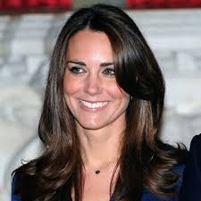
Who is this?
Meghan Markle
Taylor Swift
The Queen
Catherine, Duchess of Cambridge

Slide 43
Who is this?
Meghan Markle
Taylor Swift
The Queen
Catherine, Duchess of Cambridge

Slide 44
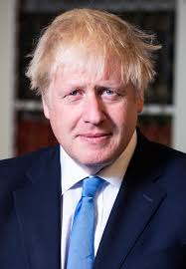
Who is this?
Donald Trump
David Cameron
Boris Johnson
The Wizard of Oz

Slide 45
Who is this?
Donald Trump
David Cameron
Boris Johnson
The Wizard of Oz

Slide 46
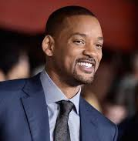
Who is this?
Will Smith
Will.I.Am
Eddy Murphy
Samuel L Jackson

Slide 47
Who is this?
Will Smith
Will.I.Am
Eddy Murphy
Samuel L Jackson

Slide 48
Who is this?
Fran Kirby
Steph Houghton
Millie Bright
Jill Scott

Slide 49
Who is this?
Fran Kirby
Steph Houghton
Millie Bright
Jill Scott

Slide 50
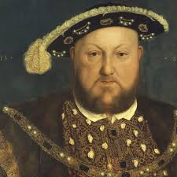
Who is this?
Richard 3rd
William the Conqueror
Charles 1st
Henry 8th

Slide 51
Who is this?
Richard 3rd
William the Conqueror
Charles 1st
Henry 8th

Slide 52
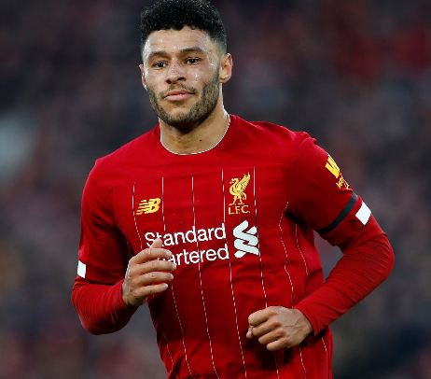
Who is this?
Marcus Rashford
Kenny Dalglish
Raheem Sterling
Alex Oxlade-Chamberlain

Slide 53
Who is this?
Marcus Rashford
Kenny Dalglish
Raheem Sterling
Alex Oxlade-Chamberlain

Slide 54
Round 5
Space

Slide 55
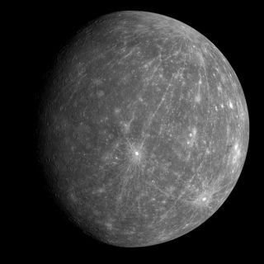
What object in the Solar System is this?
A Mercury
B An Asteriod
C Venus
D Saturn

Slide 56
What object in the Solar System is this?
A Mercury
B An Asteriod
C Venus
D Saturn

Slide 57
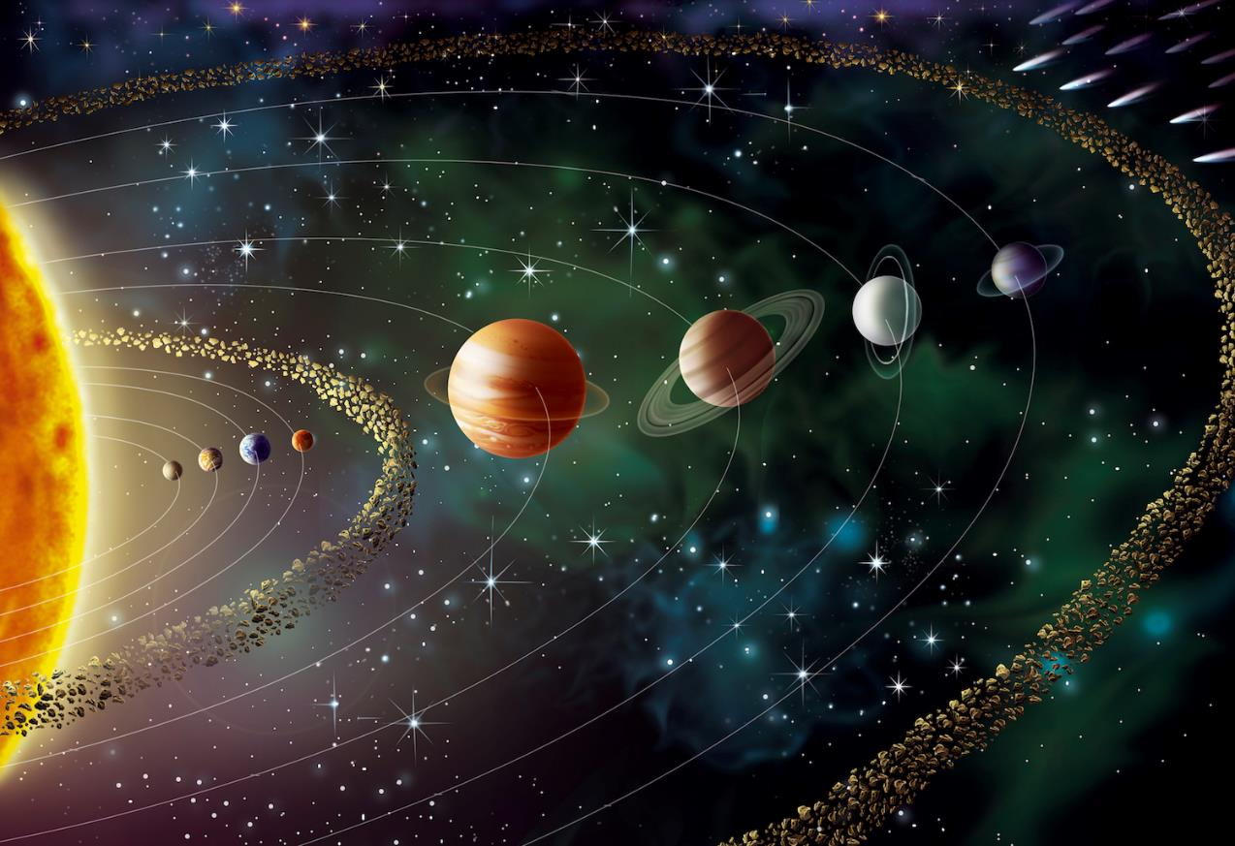
How far is the Earth from the Sun?
A 93 million miles
B 93 million light-years
C 93 million millimetres
D 93 million steps

Slide 58
How far is the Earth from the Sun?
A 93 million miles
B 93 million light-years
C 93 million millimetres
D 93 million steps

Slide 59
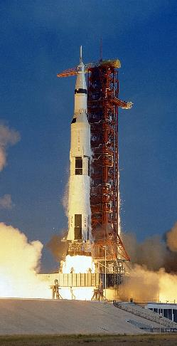
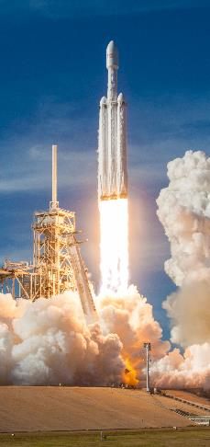
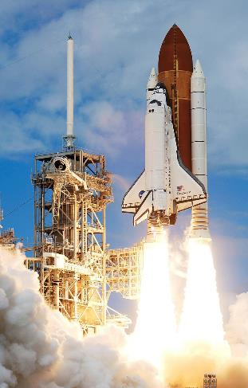
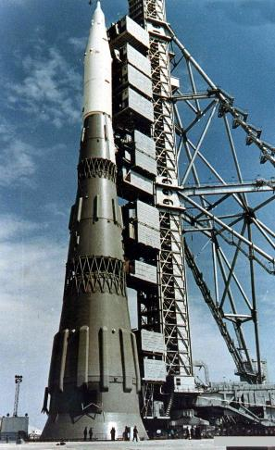
Which is the heaviest space rocket?
A
B
C
D
Saturn V
(1969)
SpaceX
Falcon Heavy (2018)
NASA Space Shuttle (2012)
Soviet Union N1
(1969)

Slide 60
Which is the heaviest space rocket?
A
B
C
D
2970
tonnes
1421
tonnes
2030
tonnes
2750
tonnes
Saturn V
(1969)
Space X Falcon Heavy (2018)
NASA Space Shuttle (2012)
Soviet Union N1
(1969

Slide 61
Which is the heaviest space rocket?
A
2970
tonnes
67 lorries
Saturn V
(1969)

Slide 62
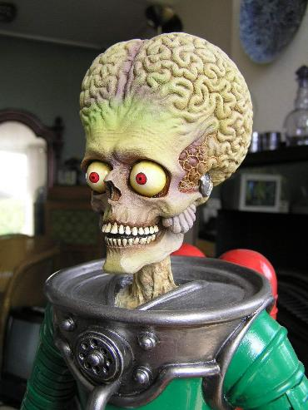
On which planet does this alien live?
A Cardassia IV
B Gognalara V
C Altair IV
D None of the above

Slide 63
On which planet does this alien live?
A Cardassia IV
B Gognalara V
C Altair IV
D None of the above

Slide 64
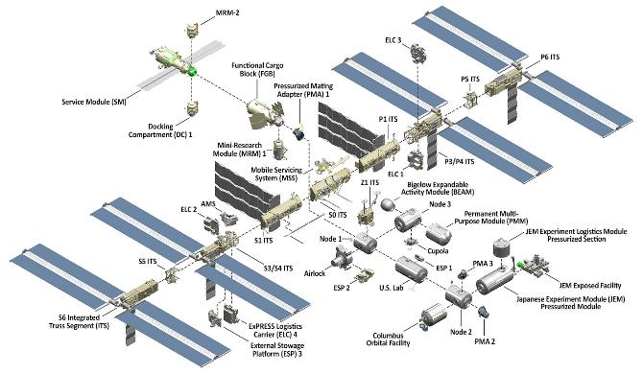
How far does the International Space Station travel in one second?
A 5 miles
B 5 metres
C 5 parsecs
D 5 football fields

Slide 65
How far does the International Space Station travel in one second?
A 5 miles
B 5 metres
C 5 parsecs
D 5 football fields
5 miles? That’s 70 football fields!

Slide 66
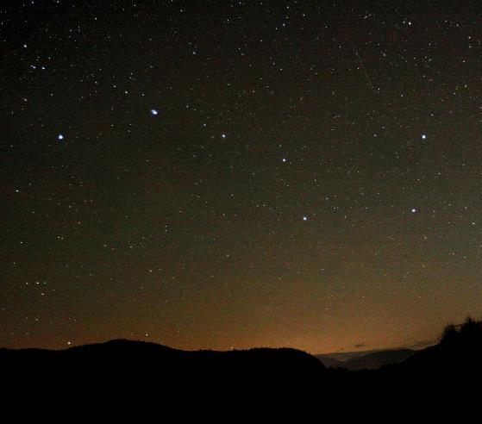
What is the name of this constellation?
A The Waggon and Horses
B The White Horse
C The Brewers
D The Plough

Slide 67
What is the name of this constellation?
A The Waggon and Horses
B The White Horse
C The Brewers
D The Plough

Slide 68
Round 6
Cars

Slide 69
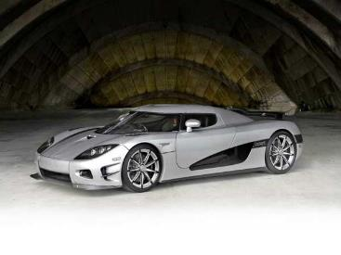
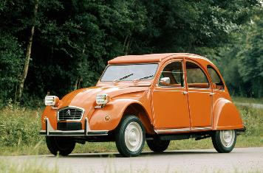
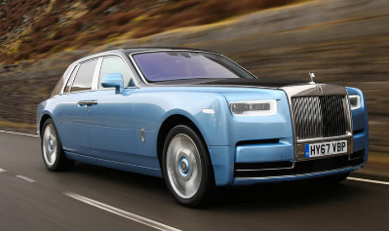
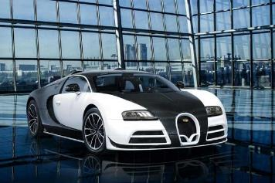
Which is the Most Expensive Car?
A. Koenigsegg CCXR Trevita
B. Citroen 2CV
C. Rolls Royce Phantom 2018
D. Mansory Vivere Bugatti Veyron

Slide 70
Which is the Most Expensive Car?
£4,000,000
£2,000
A. Koenigsegg CCXR Trevita
B. Citroen 2CV
£350,000
£3,000,000
C. Rolls Royce Phantom 2018
D. Mansory Vivere Bugatti Veyron

Slide 71
Which Car Make has this Badge?
A. Ford
B. Mercedes
C. Toyota
D. Tesla

Slide 72
Which Car Make has this Badge?
A. Ford
B. Mercedes
C. Toyota
D. Tesla

Slide 73
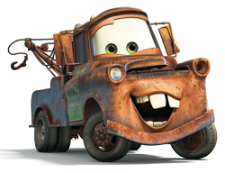
Name this Truck
A. Lightning McQueen
B. Mater
C. Doc Hudson
D. Batmobile

Slide 74
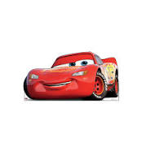
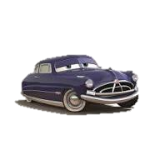
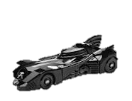
Name this Truck
A. Lightning McQueen
B. Mater
C. Doc Hudson
D. Batmobile

Slide 75
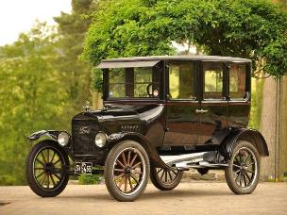
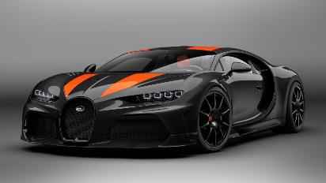
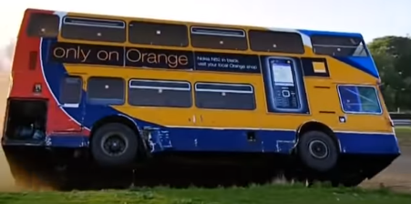
Which is the FASTEST?
A. Model T Ford
C. Bugatti Chiron Super Sport 300+
B. Mater
D. Double-Decker Bus (Top Gear)

Slide 76
Which is the FASTEST?
45 mph
A. Model T Ford
C. Bugatti Chiron Super Sport 300+
304 mph
B. Mater
Very very slow
D. Double-Decker Bus (Top Gear)
60 - 70 mph

Slide 77
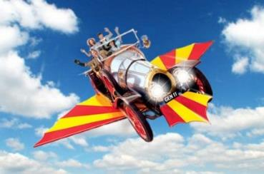
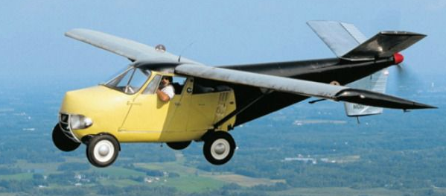
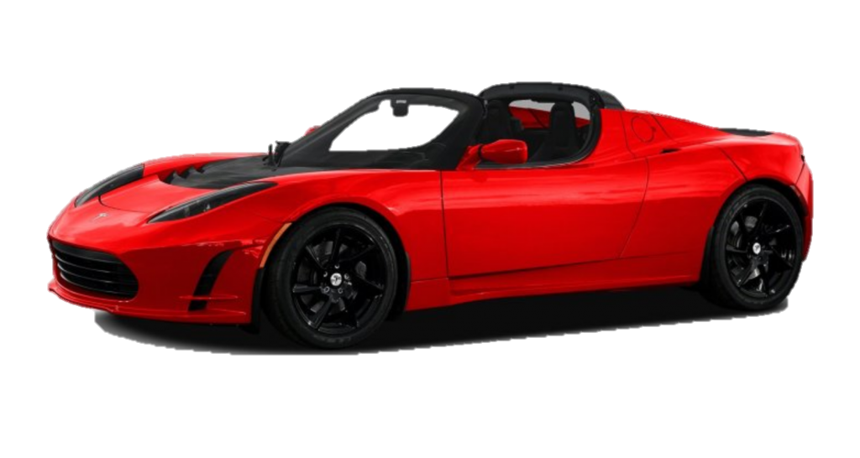
Which Car is travelling around Space?
A. Chitty Chitty Bang Bang
B. Model T Ford
D. Tesla Roadster
C. Taylor Aerocar (1954)

Slide 78
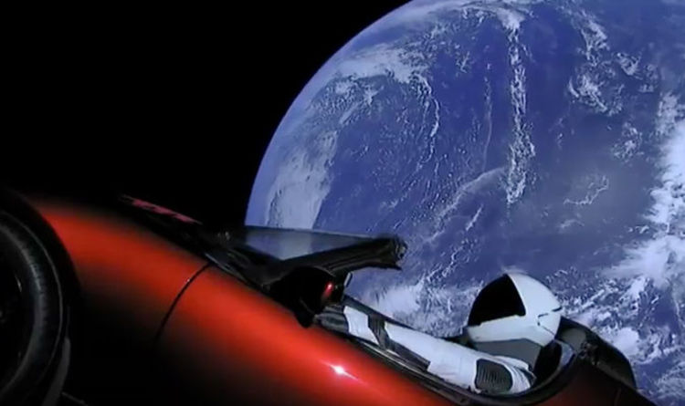
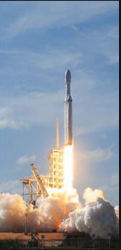
Which Car is travelling around Space?
Launched in 2019 on SpaceX Falcon Heavy
D. Tesla Roadster

Slide 79
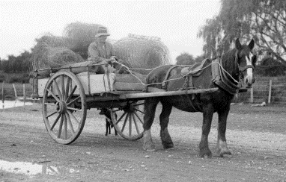
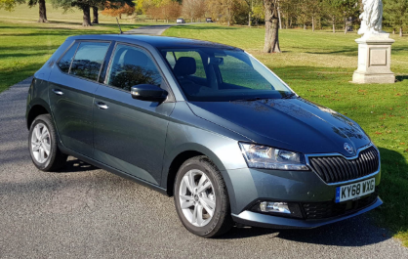
Which Car does Bob drive?
A. Bugatti Chiron Super Sport 300+
B. Horse and Cart
C. Skoda Fabia
D. Rolls Royce Phantom 2018

Slide 80
Which Car does Bob drive?
A. Bugatti Chiron Super Sport 300+
B. Horse and Cart
C. Skoda Fabia
D. Rolls Royce Phantom 2018

Slide 81
Round 7
Food and Drink

Slide 82
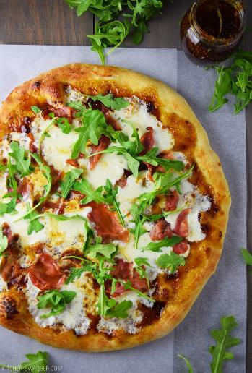
What country is Pizza from?
England
Germany
Italy
Spain

Slide 83
What country is Pizza from?
England
Germany
Italy
Spain

Slide 84
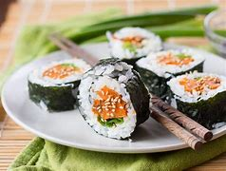
What country is Sushi from?
Spain
France
Australia
Japan

Slide 85
What country is Sushi from?
Spain
France
Australia
Japan

Slide 86
What country is Fish and Chips from?
England
Iceland
America
France

Slide 87
What country is Fish and Chips from?
England
Iceland
America
France

Slide 88
What country are Snails from?
America
Germany
Norway
France

Slide 89
What country are Snails from?
America
Germany
Norway
France

Slide 90
What country is Paella from?
Sweden
Spain
Austria
Japan

Slide 91
What country is Paella from?
Sweden
Spain
Austria
Japan

Slide 92
What country is Fried Chicken from?
America
England
China
Thailand

Slide 93
What country is Fried Chicken from?
America
England
China
Thailand

Slide 94
The End!

